Slide 1
Sequential Circuits
Reference: Moris Mano 4th Edition
Chapter 5

Slide 2
Types of Logic Circuits
Combinational Logic Circuits
Sequential Circuits

Slide 3
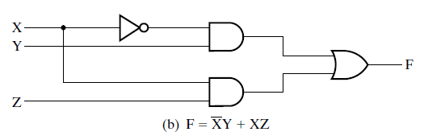
Combinational VS Sequential Circuits
Combinational Logic Circuits
In which variables are combined by the logical operations
Output depends on inputs and logic operations
Logic Diagram of a Combinational Circuit

Slide 4
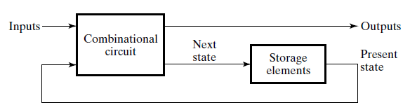
Combinational VS Sequential Circuits (contd.)
Sequential Circuits
Which include storage elements
Output depends on input and the value of storage element
Logic Diagram of a Sequential Circuit

Slide 5
Sample Program
int a, b, c, d, r;
a = 10;
b = 5;
c = a + b;
d = a - b;
r = c + d;

Slide 6
Processor executing sample program
Registers
int a, b, c, d, r;
a = 10;
b = 5;
c = a + b;
d = a - b;
r = c + d;
a = 10
Adder-Subtractor
b = 5
c
d
r

Slide 7
Processor executing sample program
Registers
int a, b, c, d, r;
a = 10;
b = 5;
c = a + b;
d = a - b;
r = c + d;
a = 10
Adder-Subtractor
b = 5
c
d
r

Slide 8
Processor executing sample program
Registers
int a, b, c, d, r;
a = 10;
b = 5;
c = a + b;
d = a - b;
r = c + d;
a = 10
Adder-Subtractor
b = 5
c = 15
d
r

Slide 9
Processor executing sample program
Registers
int a, b, c, d, r;
a = 10;
b = 5;
c = a + b;
d = a - b;
r = c + d;
a=10
Adder-Subtractor
b=5
c=15
d
r

Slide 10
Processor executing sample program
Registers
int a, b, c, d, r;
a = 10;
b = 5;
c = a + b;
d = a - b;
r = c + d;
a=10
Adder-Subtractor
b=5
c=15
d=5
r

Slide 11
Processor executing sample program
Registers
int a, b, c, d, r;
a = 10;
b = 5;
c = a + b;
d = a - b;
r = c + d;
a=10
Adder-Subtractor
b=5
c=15
d=5
r

Slide 12
Processor executing sample program
Registers
int a, b, c, d, r;
a = 10;
b = 5;
c = a + b;
d = a - b;
r = c + d;
a=10
Adder-Subtractor
b=5
c=15
d=5
r=20

Slide 13
Processor executing sample program
Registers
int a, b, c, d, r;
a = 10;
b = 5;
c = a + b;
d = a - b;
r = c + d;
a = a * 10; ???
a=10
Adder-Subtractor
b=5
c=15
d=5
r=20

Slide 14
Processor executing sample program
Registers
Register A is still holding the data
that we saved in line 1
int a, b, c, d, r;
a = 10;
b = 5;
c = a + b;
d = a - b;
r = c + d;
a = a * 10; ???
a=10
Adder-Subtractor
b=5
c=15
d=5
r=20
How long will Register A hold its data?
Register A will keep holding this data until we overwrite it
Notes:
We are going to design a n-bit register. We need some circuit to save 1 bit. Using N copies of this circuit, we can save n bits.

Slide 15
Saving information in Digital Systems

Slide 16
Storage Element
Storage elements are circuits
that store binary information for indefinite time
Can change their state(value stored) on the basis of input signal

Slide 17
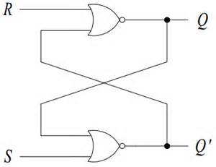
SR Latch
R = Reset
Q = Information
Stored
Input Signals
Q’ = Complement
of Information
Stored
S = Set
Logic Diagram of SR Latch
Set means Set the latch i.e. save 1 in it
Reset means Reset the latch i.e. save 0 in it

Slide 18
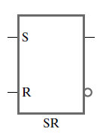
SR Latch
Standard Graphic Symbol

Slide 19
Function Table of SR Latch
Input |  | Output |  | State
S | R | Q | Q’
0 | 0
0 | 1
1 | 0
1 | 1
Function Table

Slide 20
ShortCircuiting
if((Statement1)&&(Statement2)&&(Statement3))
{
//do something
}
Else
{
//do something else
}

Slide 21
ShortCircuiting
if((Statement1)&&(Statement2)&&(Statement3))
{
//do something
}
Else
{
//do something else
}
If Statement1 is false, what will be the value of expression 1?
Expression 1

Slide 22
ShortCircuiting
if((Statement1)&&(Statement2)&&(Statement3))
{
//do something
}
Else
{
//do something else
}
If Statement1 is false, Expression1 will be false.
Expression 1

Slide 23
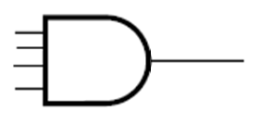
ShortCircuiting
Input |  | Output
X | Y | (XY)
0 | 0 | 0
0 | 1 | 0
1 | 0 | 0
1 | 1 | 1
…
…
0
…
0
AND Operation
When will NAND shortcircuit?
What about OR and NOR Gates?

Slide 24
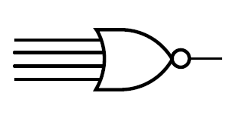
ShortCircuiting
.
.
1
.
0
Input |  | Output
X | Y | (X+Y)’
0 | 0 | 1
0 | 1 | 0
1 | 0 | 0
1 | 1 | 0

Slide 25
Function Table of SR Latch
1
Input |  | Output |  | State
S | R | Q | Q’
0 | 0
0 | 1
1 | 0
1 | 1
Function Table
1
Which gate will shortcircuit?

Slide 26
Function Table of SR Latch
1
Input |  | Output |  | State
S | R | Q | Q’
0 | 0
0 | 1
1 | 0
1 | 1 | 0 | 0
0
0
Function Table
1
Both NOR gates will shortciruit and give output 0.

Slide 27
Function Table of SR Latch
1
Input |  | Output |  | State
S | R | Q | Q’
0 | 0
0 | 1
1 | 0
1 | 1 | 0 | 0 | Undefined
0
0
Function Table
1
Both Q and Q’ are zero → Undefined State
S = 1 means Set the Latch i.e. Save 1
R = 1 means Reset the Latch i.e. Save 0
Set and Reset the Latch
at the same time

Slide 28
Function Table of SR Latch
0
Input |  | Output |  | State
S | R | Q | Q’
0 | 0
0 | 1
1 | 0
1 | 1 | 0 | 0 | Undefined
Function Table
1
Which gate will shortcircuit now?

Slide 29
Function Table of SR Latch
0
Input |  | Output |  | State
S | R | Q | Q’
0 | 0
0 | 1
1 | 0
1 | 1 | 0 | 0 | Undefined
0
Function Table
1
This gate will shortcircuit and give output first.

Slide 30
Function Table of SR Latch
0
Input |  | Output |  | State
S | R | Q | Q’
0 | 0
0 | 1
1 | 0
1 | 1 | 0 | 0 | Undefined
0
0
Function Table
1
This gate will shortcircuit and give output first.

Slide 31
Function Table of SR Latch
0
1
Input |  | Output |  | State
S | R | Q | Q’
0 | 0
0 | 1
1 | 0 | 1 | 0
1 | 1 | 0 | 0 | Undefined
0
0
Function Table
1
This gate will shortcircuit and give output first.

Slide 32
Function Table of SR Latch
0
1
Input |  | Output |  | State
S | R | Q | Q’
0 | 0
0 | 1
1 | 0 | 1 | 0 | Set
1 | 1 | 0 | 0 | Undefined
0
0
Function Table
1
S=1 means Set the latch
i.e. Save one in it
1 has been saved in Q → Latch has been Set.

Slide 33
Function Table of SR Latch
1
Input |  | Output |  | State
S | R | Q | Q’
0 | 0
0 | 1
1 | 0 | 1 | 0 | Set
1 | 1 | 0 | 0 | Undefined
Function Table
0
Which gate will shortcircuit now?

Slide 34
Function Table of SR Latch
1
0
Input |  | Output |  | State
S | R | Q | Q’
0 | 0
0 | 1
1 | 0 | 1 | 0 | Set
1 | 1 | 0 | 0 | Undefined
Function Table
0
This gate will shortcircuit and give output first.

Slide 35
Function Table of SR Latch
1
0
Input |  | Output |  | State
S | R | Q | Q’
0 | 0
0 | 1
1 | 0 | 1 | 0 | Set
1 | 1 | 0 | 0 | Undefined
0
Function Table
0
This gate will shortcircuit and give output first.

Slide 36
Function Table of SR Latch
1
0
Input |  | Output |  | State
S | R | Q | Q’
0 | 0
0 | 1 | 0 | 1 | Reset
1 | 0 | 1 | 0 | Set
1 | 1 | 0 | 0 | Undefined
0
1
Function Table
0
R = 1 means
Reset the latch
i.e. save Zero in it
Zero has been saved in the latch → Latch has been Reset

Slide 37
Function Table of SR Latch
0
Input |  | Output |  | State
S | R | Q | Q’
0 | 0
0 | 1 | 0 | 1 | Reset
1 | 0 | 1 | 0 | Set
1 | 1 | 0 | 0 | Undefined
Function Table
0
Which gate will shortcircuit now?

Slide 38
Function Table of SR Latch
0
Input |  | Output |  | State
S | R | Q | Q’
0 | 0
0 | 1 | 0 | 1 | Reset
1 | 0 | 1 | 0 | Set
1 | 1 | 0 | 0 | Undefined
Q’
Values at time t
Q
Function Table
0
None. Both will output according to their second input lines.

Slide 39
NOR Operation
Input |  | Output
X | Y | (X+Y)’
0 | 0 | 1
0 | 1 | 0
1 | 0 | 0
1 | 1 | 0
When X is 0, output = Y’

Slide 40
Function Table of SR Latch
Values at time t+1
0
Q
Input |  | Output |  | State
S | R | Q | Q’
0 | 0 | Q | Q’ | Retain
0 | 1 | 0 | 1 | Reset
1 | 0 | 1 | 0 | Set
1 | 1 | 0 | 0 | Undefined
Q’
Values at time t
Q
Q’
Function Table
0
S=0 → Do not Set
R=0 → Do not Reset
So, Retain previous value
On input (0,0), Latch is retaining its previous value.

Slide 41
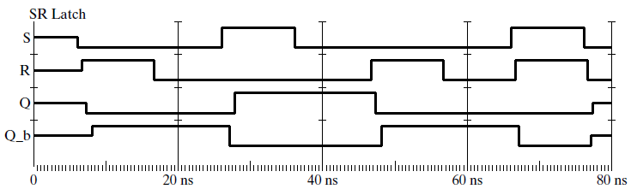
How SR Latch Works
Function Table
Input |  | Output |  | State
S | R | Q | Q’
1 | 0 | 1 | 0 | Set
0 | 0 | 1 | 0
0 | 1 | 0 | 1 | Reset
0 | 0 | 0 | 1
1 | 1 | 0 | 0 | Undefined
Timing diagram / Logic Simulation of SR Latch

Slide 42
How SR Latch Works
Function Table
Input |  | Output |  | State
S | R | Q | Q’
1 | 0 | 1 | 0 | Set
0 | 0 | 1 | 0
0 | 1 | 0 | 1 | Reset
0 | 0 | 0 | 1
1 | 1 | 0 | 0 | Undefined
Timing diagram / Logic Simulation of SR Latch

Slide 43
How SR Latch Works … Initial State
Function Table
Input |  | Output |  | State
S | R | Q | Q’
1 | 0 | 1 | 0 | Set
0 | 0 | 1 | 0
0 | 1 | 0 | 1 | Reset
0 | 0 | 0 | 1
1 | 1 | 0 | 0 | Undefined
Initially:
Inputs &
States
(outputs)
Unknown
Timing diagram / Logic Simulation of SR Latch

Slide 44
How SR Latch Works … (R=1, S=0)
1
Function Table
Input |  | Output |  | State
S | R | Q | Q’
1 | 0 | 1 | 0 | Set
0 | 0 | 1 | 0
0 | 1 | 0 | 1 | Reset
0 | 0 | 0 | 1
1 | 1 | 0 | 0 | Undefined
0
Which NOR Gate
will give output
First?
(Shortcircuiting)
Timing diagram / Logic Simulation of SR Latch

Slide 45
How SR Latch Works … (R=1, S=0)
1
0
Input |  | Output |  | State
S | R | Q | Q’
1 | 0 | 1 | 0 | Set
0 | 0 | 1 | 0
0 | 1 | 0 | 1 | Reset
0 | 0 | 0 | 1
1 | 1 | 0 | 0 | Undefined
0
1
0
Timing diagram / Logic Simulation of SR Latch

Slide 46
How SR Latch Works … (R=1, S=0)
1
0
Input |  | Output |  | State
S | R | Q | Q’
1 | 0 | 1 | 0 | Set
0 | 0 | 1 | 0
0 | 1 | 0 | 1 | Reset
0 | 0 | 0 | 1
1 | 1 | 0 | 0 | Undefined
0
1
0
What is this?
Timing diagram / Logic Simulation of SR Latch
Notes:
This is Gate delay.

Slide 47
How SR Latch Works … (R=1, S=0)
1
0
Input |  | Output |  | State
S | R | Q | Q’
1 | 0 | 1 | 0 | Set
0 | 0 | 1 | 0
0 | 1 | 0 | 1 | Reset
0 | 0 | 0 | 1
1 | 1 | 0 | 0 | Undefined
0
1
0
Timing diagram / Logic Simulation of SR Latch

Slide 48
How SR Latch Works … (R=0, S=0)
Previous State
0
Input |  | Output |  | State
S | R | Q | Q’
1 | 0 | 1 | 0 | Set
0 | 0 | 1 | 0
0 | 1 | 0 | 1 | Reset
0 | 0 | 0 | 1
1 | 1 | 0 | 0 | Undefined
1
Timing diagram / Logic Simulation of SR Latch

Slide 49
How SR Latch Works … (R=0, S=0)
Previous State
0
0
Input |  | Output |  | State
S | R | Q | Q’
1 | 0 | 1 | 0 | Set
0 | 0 | 1 | 0
0 | 1 | 0 | 1 | Reset
0 | 0 | 0 | 1
1 | 1 | 0 | 0 | Undefined
1
0
Timing diagram / Logic Simulation of SR Latch

Slide 50
How SR Latch Works … (R=0, S=0)
New State
0
0
Input |  | Output |  | State
S | R | Q | Q’
1 | 0 | 1 | 0 | Set
0 | 0 | 1 | 0
0 | 1 | 0 | 1 | Reset
0 | 0 | 0 | 1
1 | 1 | 0 | 0 | Undefined
1
0
1
0
Timing diagram / Logic Simulation of SR Latch

Slide 51
How SR Latch Works … (R=0, S=0)
0
0
Input |  | Output |  | State
S | R | Q | Q’
1 | 0 | 1 | 0 | Set
0 | 0 | 1 | 0
0 | 1 | 0 | 1 | Reset
0 | 0 | 0 | 1
1 | 1 | 0 | 0 | Undefined
1
0
1
0
Input(0,0)
maintaining the
output signal
Timing diagram / Logic Simulation of SR Latch

Slide 52
How SR Latch Works … (R=0, S=1)
0
Input |  | Output |  | State
S | R | Q | Q’
1 | 0 | 1 | 0 | Set
0 | 0 | 1 | 0
0 | 1 | 0 | 1 | Reset
0 | 0 | 0 | 1
1 | 1 | 0 | 0 | Undefined
1
Which NOR Gate
will give output
First?
Timing diagram / Logic Simulation of SR Latch

Slide 53
How SR Latch Works … (R=0, S=1)
0
1
Input |  | Output |  | State
S | R | Q | Q’
1 | 0 | 1 | 0 | Set
0 | 0 | 1 | 0
0 | 1 | 0 | 1 | Reset
0 | 0 | 0 | 1
1 | 1 | 0 | 0 | Undefined
0
0
1
Timing diagram / Logic Simulation of SR Latch

Slide 54
How SR Latch Works … (R=0, S=0)
Previous State
0
1
Input |  | Output |  | State
S | R | Q | Q’
1 | 0 | 1 | 0 | Set
0 | 0 | 1 | 0
0 | 1 | 0 | 1 | Reset
0 | 0 | 0 | 1
1 | 1 | 0 | 0 | Undefined
0
0
Timing diagram / Logic Simulation of SR Latch

Slide 55
How SR Latch Works … (R=0, S=0)
Next State
0
1
Input |  | Output |  | State
S | R | Q | Q’
1 | 0 | 1 | 0 | Set
0 | 0 | 1 | 0
0 | 1 | 0 | 1 | Reset
0 | 0 | 0 | 1
1 | 1 | 0 | 0 | Undefined
0
1
0
0
Timing diagram / Logic Simulation of SR Latch

Slide 56
How SR Latch Works … (R=0, S=0)
0
1
Input |  | Output |  | State
S | R | Q | Q’
1 | 0 | 1 | 0 | Set
0 | 0 | 1 | 0
0 | 1 | 0 | 1 | Reset
0 | 0 | 0 | 1
1 | 1 | 0 | 0 | Undefined
0
1
0
0
Input(0,0)
maintaining the
output signal
Timing diagram / Logic Simulation of SR Latch

Slide 57
How SR Latch Works … (R=1, S=0)
Input |  | Output |  | State
S | R | Q | Q’
1 | 0 | 1 | 0 | Set
0 | 0 | 1 | 0
0 | 1 | 0 | 1 | Reset
0 | 0 | 0 | 1
1 | 1 | 0 | 0 | Undefined
Timing diagram / Logic Simulation of SR Latch

Slide 58
How SR Latch Works … (R=1, S=1)
1
Input |  | Output |  | State
S | R | Q | Q’
1 | 0 | 1 | 0 | Set
0 | 0 | 1 | 0
0 | 1 | 0 | 1 | Reset
0 | 0 | 0 | 1
1 | 1 | 0 | 0 | Undefined
1
Which NOR Gate
will give output
First?
Timing diagram / Logic Simulation of SR Latch

Slide 59
How SR Latch Works … (R=1, S=1)
1
0
Input |  | Output |  | State
S | R | Q | Q’
1 | 0 | 1 | 0 | Set
0 | 0 | 1 | 0
0 | 1 | 0 | 1 | Reset
0 | 0 | 0 | 1
1 | 1 | 0 | 0 | Undefined
0
1
Both outputs
should be
complement
of each other.
Timing diagram / Logic Simulation of SR Latch

Slide 60
How SR Latch Works … (R=0, S=0)
Previous State
0
0
Input |  | Output |  | State
S | R | Q | Q’
1 | 0 | 1 | 0 | Set
0 | 0 | 1 | 0
0 | 1 | 0 | 1 | Reset
0 | 0 | 0 | 1
1 | 1 | 0 | 0 | Undefined
0
0
Simultaneous
input change
Timing diagram / Logic Simulation of SR Latch

Slide 61
How SR Latch Works … (R=0, S=0)
New State
0
1
Input |  | Output |  | State
S | R | Q | Q’
1 | 0 | 1 | 0 | Set
0 | 0 | 1 | 0
0 | 1 | 0 | 1 | Reset
0 | 0 | 0 | 1
1 | 1 | 0 | 0 | Undefined
0
0
1
0
Both outputs
should be
complement
of each other.
Timing diagram / Logic Simulation of SR Latch

Slide 62
How SR Latch Works … (R=0, S=0)
Previous State
0
1
Input |  | Output |  | State
S | R | Q | Q’
1 | 0 | 1 | 0 | Set
0 | 0 | 1 | 0
0 | 1 | 0 | 1 | Reset
0 | 0 | 0 | 1
1 | 1 | 0 | 0 | Undefined
1
1
1
0
Both outputs
should be
complement
of each other.
Timing diagram / Logic Simulation of SR Latch

Slide 63
How SR Latch Works … (R=0, S=0)
New State
0
0
Input |  | Output |  | State
S | R | Q | Q’
1 | 0 | 1 | 0 | Set
0 | 0 | 1 | 0
0 | 1 | 0 | 1 | Reset
0 | 0 | 0 | 1
1 | 1 | 0 | 0 | Undefined
1
1
0
0
Both outputs
should be
complement
of each other.
Timing diagram / Logic Simulation of SR Latch

Slide 64
How SR Latch Works … (R=0, S=0)
Previous State
0
0
Input |  | Output |  | State
S | R | Q | Q’
1 | 0 | 1 | 0 | Set
0 | 0 | 1 | 0
0 | 1 | 0 | 1 | Reset
0 | 0 | 0 | 1
1 | 1 | 0 | 0 | Undefined
0
0
0
0
Both outputs
should be
complement
of each other.
Timing diagram / Logic Simulation of SR Latch

Slide 65
How SR Latch Works … (R=0, S=0)
New State
0
1
Input |  | Output |  | State
S | R | Q | Q’
1 | 0 | 1 | 0 | Set
0 | 0 | 1 | 0
0 | 1 | 0 | 1 | Reset
0 | 0 | 0 | 1
1 | 1 | 0 | 0 | Undefined
0
0
1
0
Input Sequence
(1,1),(0,0) →
Oscillation →
Undefined
State
Timing diagram / Logic Simulation of SR Latch

Slide 66
How SR Latch Works
Input |  | Output |  | State
S | R | Q | Q’
1 | 0 | 1 | 0 | Set
0 | 0 | 1 | 0
0 | 1 | 0 | 1 | Reset
0 | 0 | 0 | 1
1 | 1 | 0 | 0 | Undefined
Once Set or Reset
Save previous
State on input
(S,R) =(0,0)
Timing diagram / Logic Simulation of SR Latch

Slide 67
Test your Concepts
How can we avoid Undefined state?
Notes:
Give complement of S in R i.e. Input can be either (0,1) or (1,0)

Slide 68
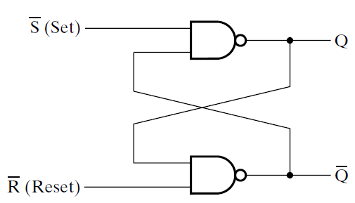
S’R’ Latch
Input |  | Output |  | State
S’ | R’ | Q | Q’
0 | 0
0 | 1
1 | 0
1 | 1
Function Table

Slide 69
S’R’ Latch
Input |  | Output |  | State
S’ | R’ | Q | Q’
0 | 1 | 1 | 0 | Set
1 | 1 | 1 | 0
1 | 0 | 0 | 1 | Reset
1 | 1 | 0 | 1
0 | 0 | 1 | 1 | Undefined

Slide 70
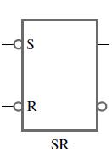
S’R’ Latch
Standard Graphic Symbol

Slide 71
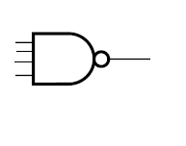
NAND Operation
Input |  | Output
X | Y | (XY)’
0 | 0 | 1
0 | 1 | 1
1 | 0 | 1
1 | 1 | 0
.
.
0
.
1
NAND shortcircuits on 0 and gives output 1.

Slide 72
How S’R’ Latch Works…(S’=0, R’=0)
0
Input |  | Output |  | State
S’ | R’ | Q | Q’
0 | 1 | 1 | 0 | Set
1 | 1 | 1 | 0
1 | 0 | 0 | 1 | Reset
1 | 1 | 0 | 1
0 | 0 | 1 | 1 | Undefined
0
Which NAND will shortcircuit?

Slide 73
How S’R’ Latch Works…(S’=0, R’=0)
0
1
Input |  | Output |  | State
S’ | R’ | Q | Q’
0 | 1 | 1 | 0 | Set
1 | 1 | 1 | 0
1 | 0 | 0 | 1 | Reset
1 | 1 | 0 | 1
0 | 0 | 1 | 1 | Undefined
1
0
Undefined State:
Both outputs should be complement of each other.
Both will shortcircuit

Slide 74
How S’R’ Latch Works…(S’=0, R’=1)
0
Input |  | Output |  | State
S’ | R’ | Q | Q’
0 | 1 | 1 | 0 | Set
1 | 1 | 1 | 0
1 | 0 | 0 | 1 | Reset
1 | 1 | 0 | 1
0 | 0 | 1 | 1 | Undefined
1
Which NAND Gate
will give output
First?

Slide 75
How S’R’ Latch Works…(S’=0, R’=1)
0
1
Input |  | Output |  | State
S’ | R’ | Q | Q’
0 | 1 | 1 | 0 | Set
1 | 1 | 1 | 0
1 | 0 | 0 | 1 | Reset
1 | 1 | 0 | 1
0 | 0 | 1 | 1 | Undefined
1
This NAND will shortcircuit

Slide 76
How S’R’ Latch Works…(S’=0, R’=1)
0
1
Input |  | Output |  | State
S’ | R’ | Q | Q’
0 | 1 | 1 | 0 | Set
1 | 1 | 1 | 0
1 | 0 | 0 | 1 | Reset
1 | 1 | 0 | 1
0 | 0 | 1 | 1 | Undefined
1
0
1
Latch has been Set i.e. 1 has been saved in output Q.

Slide 77
How S’R’ Latch Works…(S’=1, R’=0)
1
Input |  | Output |  | State
S’ | R’ | Q | Q’
0 | 1 | 1 | 0 | Set
1 | 1 | 1 | 0
1 | 0 | 0 | 1 | Reset
1 | 1 | 0 | 1
0 | 0 | 1 | 1 | Undefined
0
Which NAND Gate
will give output
First?

Slide 78
How S’R’ Latch Works…(S’=1, R’=0)
1
Input |  | Output |  | State
S’ | R’ | Q | Q’
0 | 1 | 1 | 0 | Set
1 | 1 | 1 | 0
1 | 0 | 0 | 1 | Reset
1 | 1 | 0 | 1
0 | 0 | 1 | 1 | Undefined
1
0
This NAND will shortcircuit

Slide 79
How S’R’ Latch Works…(S’=1, R’=0)
1
0
Input |  | Output |  | State
S’ | R’ | Q | Q’
0 | 1 | 1 | 0 | Set
1 | 1 | 1 | 0
1 | 0 | 0 | 1 | Reset
1 | 1 | 0 | 1
0 | 0 | 1 | 1 | Undefined
1
1
0
Latch has been Reset i.e. 0 has been saved in output Q.

Slide 80
NAND Operation
Input |  | Output
X | Y | (XY)’
0 | 0 | 1
0 | 1 | 1
1 | 0 | 1
1 | 1 | 0
If X = 1, Output = Y’

Slide 81
How S’R’ Latch Works…(S’=1, R’=1)
Previous State
1
Q(t)
Input |  | Output |  | State
S’ | R’ | Q | Q’
0 | 1 | 1 | 0 | Set
1 | 1 | 1 | 0
1 | 0 | 0 | 1 | Reset
1 | 1 | 0 | 1
0 | 0 | 1 | 1 | Undefined
Q’(t)
1

Slide 82
How S’R’ Latch Works…(S’=1, R’=1)
Previous State
1
Q(t)
Input |  | Output |  | State
S’ | R’ | Q | Q’
0 | 1 | 1 | 0 | Set
1 | 1 | 1 | 0
1 | 0 | 0 | 1 | Reset
1 | 1 | 0 | 1
0 | 0 | 1 | 1 | Undefined
Q’(t)
Q(t)
Q’(t)
1

Slide 83
How S’R’ Latch Works…(S’=1, R’=1)
New State
1
Q(t+1) = Q(t)
Input |  | Output |  | State
S’ | R’ | Q | Q’
0 | 1 | 1 | 0 | Set
1 | 1 | 1 | 0
1 | 0 | 0 | 1 | Reset
1 | 1 | 0 | 1
0 | 0 | 1 | 1 | Undefined
Q’(t)
Q(t)
1
Q’(t+1) = Q’(t)
Latch is retaining its value i.e. Q(t+1) = Q(t)

Slide 84
How S’R’ Latch Works…(S’=1, R’=1)
Previous State
1
0
Input |  | Output |  | State
S’ | R’ | Q | Q’
0 | 1 | 1 | 0 | Set
1 | 1 | 1 | 0
1 | 0 | 0 | 1 | Reset
1 | 1 | 0 | 1
0 | 0 | 1 | 1 | Undefined
1
1
Example

Slide 85
How S’R’ Latch Works…(S’=1, R’=1)
New State
1
0
Input |  | Output |  | State
S’ | R’ | Q | Q’
0 | 1 | 1 | 0 | Set
1 | 1 | 1 | 0
1 | 0 | 0 | 1 | Reset
1 | 1 | 0 | 1
0 | 0 | 1 | 1 | Undefined
1
0
1
1

Slide 86
SR Latch VS S’R’ Latch
S’R’ working for Complements of Inputs (S,R)

Slide 87
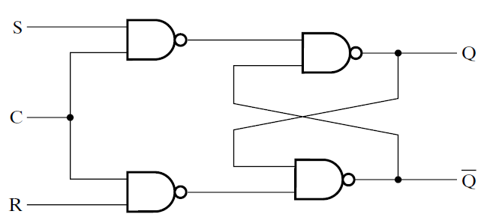
SR Latch with Control Input
Input
C | S | R | Next State Of Q
0 | X | X | No Change
1 | 0 | 0 | No Change
1 | 0 | 1 | Q=0, Reset
1 | 1 | 0 | Q=1, Set
1 | 1 | 1 | Undefined
Logic Diagram
Function Table

Slide 88
SR Latch with Control Input
X NAND 1 = X’
Input
C | S | R | Next State Of Q
0 | X | X | No Change
1 | 0 | 0 | No Change
1 | 0 | 1 | Q=0, Reset
1 | 1 | 0 | Q=1, Set
1 | 1 | 1 | Undefined
S’
1
X | Y | (XY)’
0 | 0 | 1
0 | 1 | 1
1 | 0 | 1
1 | 1 | 0
R’
Truth Table of NAND

Slide 89
SR Latch with Control Input
Input
C | S | R | Next State Of Q
0 | X | X | No Change
1 | 0 | 0 | No Change
1 | 0 | 1 | Q=0, Reset
1 | 1 | 0 | Q=1, Set
1 | 1 | 1 | Undefined
S’
1
Input |  | Output |  | State
S’ | R’ | Q | Q’
0 | 1 | 1 | 0 | Set
1 | 1 | 1 | 0
1 | 0 | 0 | 1 | Reset
1 | 1 | 0 | 1
0 | 0 | 1 | 1 | Undefined
R’
S’R’ Latch
Func. Table of S’R’

Slide 90
SR Latch with Control Input
X NAND 0 = 1
Input
C | S | R | Next State Of Q
0 | X | X | No Change
1 | 0 | 0 | No Change
1 | 0 | 1 | Q=0, Reset
1 | 1 | 0 | Q=1, Set
1 | 1 | 1 | Undefined
1
0
X | Y | (XY)’
0 | 0 | 1
0 | 1 | 1
1 | 0 | 1
1 | 1 | 0
1

Slide 91
SR Latch with Control Input
Input
C | S | R | Next State Of Q
0 | X | X | No Change
1 | 0 | 0 | No Change
1 | 0 | 1 | Q=0, Reset
1 | 1 | 0 | Q=1, Set
1 | 1 | 1 | Undefined
1
0
Input |  | Output |  | State
S’ | R’ | Q | Q’
0 | 1 | 1 | 0 | Set
1 | 1 | 1 | 0
1 | 0 | 0 | 1 | Reset
1 | 1 | 0 | 1
0 | 0 | 1 | 1 | Undefined
1
When C=0
Retain previous value
S’R’ Latch
Func. Table of S’R’

Slide 92
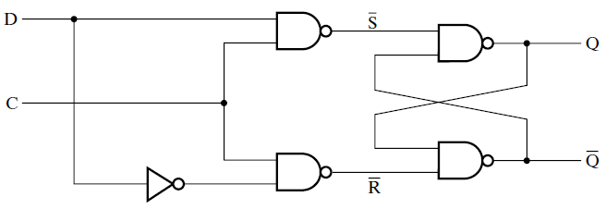
D Latch
C | D | Next State of Q
0 | X | No Change
1 | 0 | Q=0, Reset State
1 | 1 | Q = 1, Set State
C = Control Input
D = Data Input
Function Table

Slide 93
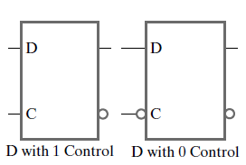
D Latch
Standard Graphic Symbol

Slide 94
D Latch
X NAND 0 = 1
D
1
0
0
1
D’
Input |  | Output |  | State
S’ | R’ | Q | Q’
0 | 1 | 1 | 0 | Set
1 | 1 | 1 | 0
1 | 0 | 0 | 1 | Reset
1 | 1 | 0 | 1
0 | 0 | 1 | 1 | Undefined
C | D | Next State of Q
0 | X | No Change
1 | 0 | Q=0, Reset State
1 | 1 | Q = 1, Set State
Function Table of D Latch
Function Table of S’R’ Latch

Slide 95
D Latch
X NAND 1 = X’
0
0
1
1
1
1
0
Input |  | Output |  | State
S’ | R’ | Q | Q’
0 | 1 | 1 | 0 | Set
1 | 1 | 1 | 0
1 | 0 | 0 | 1 | Reset
1 | 1 | 0 | 1
0 | 0 | 1 | 1 | Undefined
C | D | Next State of Q
0 | X | No Change
1 | 0 | Q=0, Reset State
1 | 1 | Q = 1, Set State
Function Table of D Latch
Function Table of S’R’ Latch

Slide 96
D Latch
X NAND 1 = X’
1
1
0
1
1
1
Input |  | Output |  | State
S’ | R’ | Q | Q’
0 | 1 | 1 | 0 | Set
1 | 1 | 1 | 0
1 | 0 | 0 | 1 | Reset
1 | 1 | 0 | 1
0 | 0 | 1 | 1 | Undefined
0
C | D | Next State of Q
0 | X | No Change
1 | 0 | Q=0, Reset State
1 | 1 | Q = 1, Set State
Function Table of D Latch
Function Table of S’R’ Latch

